Slide 1
BUSINESS SOLUTIONS LATIN AMERICAN REGION

Slide 3
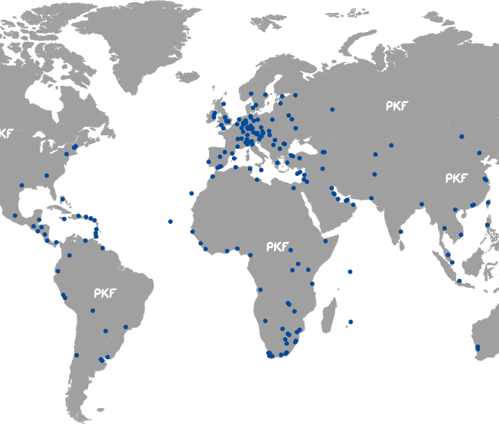
PKF Global Network
Worldwide network in accounting and business advisory services
More than $1 billion aggregate fee income
Network of member firms in 5 regions
More than 400 offices in 150 countries
14,000 staff

Slide 4
Why you choose PKF?
We work closely with our clients on issues ranging from risk advisory to corporate finance and restructuring, to provide strong support for growth and to guide them through potential obstacles such as tax and regulation. PKF’s services extend everywhere from a company’s inception and formation to its small-business phase, all the way to its needs as a large corporation working with large financial deals and mergers.
When you use a PKF member firm for business advice and accountancy services, you can be confident that the work will be carried out by dedicated professionals with international expertise. Each team is led by a partner who will deal with you directly and be your regular point of contact. As a client of a PKF member firm you are assured of:
a firm that is firmly established and respected in its own country
a partner-led service
experts who understand your market
partners who work hard to understand your specific business and its needs
knowledge of the local business landscape
rapid access to technical guidance and support from other member firms if required
seamless continuity of service for your international business needs.

Slide 5
Why you choose PKF?
What truly sets us apart is the emphasis we place on listening to your unique circumstances, and the way our decision-makers work with clients, as one global team, to provide exactly what is needed. Our presence on 6 continents gives us both the local perspective and the global reach to provide easy-to-follow recommendations every step of the way.
As the leading independent global accounting and advisory brand, collaboration is central to the PKF experience. While all members maintain full independence, our shared network allows us to offer every accounting and advisory service a company could need throughout its lifetime, producing tailor-made solutions in a complex economy.

Slide 6
PKF Global Network – Three Uniques
Global Brand Local Identity
Your identity is important in your local market. You've worked hard at it. That doesn't change when you join PKF. The PKF Brand connects you to global resources and adds international credibility.
Real People with Passion
PKF people are passionate, about the network, about quality, and about giving their best at all times. Our people are leaders in their fields, highly regarded by their peers, but remain hands on; we believe in having real conversations. And we listen when our members speak.
Not Only better. Different.
Being good at what we do is only the start. We do things differently. Collaboration brings world class services without reinventing the wheel. Technology is a critical tool in connecting our people. Regional service centers provide support, when you need it, where you need it.

Slide 7
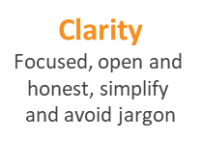
PKF Global Network
The criteria for membership are strict and selective and the requirements for maintaining membership are constantly increasing according to our clients‘ expectations.
The core values are the standards the network wishes to recognised for.
Sharing knowledge PKF creates a common understanding of a global family.
PKF member firms display these values consistently in their daily interactions with clients and with each other.

Slide 8
PKF Business Solutions Services
Bookkeeping
HR Compliance
Payroll
Accounting systems
Management reporting
Financial analysis
Data mining
Entity formation
Company secretarial
Business planning
Business liquidation
Business.solutions@pkf.com
www.pkf.com

Slide 9
Contact in Latin America
ARGENTINA
PKF Audisur
GUSTAVO HOSPITAL
ghospital@pkfargentina.com.ar
Sarmiento 663 Floor 3º (C1041 AAM) Buenos Aires
Argentina Phone: +54 -(11) 5235-6393 Fax: +54 -(11) 5235-6300 pkf@pkfargentina.com.ar
www.pkfargentina.com.ar
Subsidiary: Mendoza, Rosario
Cordoba
BRASIL
PKF Brazil Participações SRL
FELIPE PESTANA
felipe.pestana@pkfbrazil.com.br
Avenida Rio Branco, 43 15º/18º/20º andares Centro - Rio de Janeiro, RJ CEP: 20090-003 Phone: (55) 21 2211 0011
www.pkfbrazil.com.br
Main Office: São Paulo
Subsidiary: Rio de Janeiro, Macaé, Teresina, Ribeirao Preto
CHILE
PKF Chile
LUIS VICUNA
lvicuna@pkfchile.com.cl
Av. Providencia 1760, Piso 6 Providencia Región Metropolitana - Chile
Phone: (+562) 2650 4300
pkfchile@pkfchile.cl
www.pkfchile.cl
COLOMBIA
PKF Amezquita & Cia
DIANA GUTIERREZ
gdiana@amezquita.com.co
Calle 37 No. 24 – 28
Bogotá PBX: (1) 208 75 00 amezquita@amezquita.com.co
www.amezquita.com.co
Subsidiary: Medellin

Slide 10
Contact in Latin America
ECUADOR
PKF & CO. CIA. LTDA
MANUEL GARCIA
mgarcia@pkfecuador.com
Av. 9 de Octubre #1911 y Los Ríos,
Edificio Finansur, Piso 12, oficina 2
Guayaquil
PBX: +593 4 236 7833
Fax: +593 4 236 1056
pkf@pkfecuador.com
www.pkfecuador.com
Subsidiary: Quito
MEXICO
PKF México, S.C.
MONICA L. WILLIAMS DIAZ
mwilliams@pkfmex.com
Adolfo Prieto No. 1213
Col. Del Valle
Ciudad de México
México
Phone: (52-55) 5097 3235
Fax: (52-55) 5682 4321
pkfwilliams@pkfmex.com
www.pkfmexico.com
PARAGUAY
PKF Controller Contadores & Auditores
HECTOR CÁCERES
hcaceres@pkf-controller.com.py
Asunción Cecilio Da Silva e/ Papa Juan XXIII y Narciso R. Colmán
Phone: (595) 21 603044
Ciudad del Este Av. Mcal. López y Calle 5
Barrio San José Edificio Corporativo Beck, Oficina 101 y 102 Phone: (595) 61 511610
Asistencia.técnica@pkf-controller.com.py
www.pkf-controller.com.py
PERU
PKF VILA NARANJO
ESTEBAN HILGERT
ehilgert@pkfperu.com
Av. Paseo de la República 3557, Piso 2, San isidro / Lima
Phone: + 511 4415553 / 4426116
vilanaranjo@pkfperu.com
www.pkfperu.com

Slide 11
Contact in Latin America
URUGUAY
PKF Uruguay
FERNANDO SALTO
fsalto@pkfuruguay.com
Avenida Italia 6282
esquina Córcega CP 11.500 Montevideo Uruguay
Phone: (598) 600 2255;
(598) 2605 0133; (598) 2605 1420;
estudio@pkfuruguay.com.uy
www.pkfuruguay.com.uy
VENEZUELA
PKF Cabrera Colmenares & Asoc.
TOMAS CARPENTIERI
tcarpentieri@pkfve.com
Av. Tamanaco con Av. Francisco de Miranda, Torre Seguros Sudamérica, Piso 2, Ofc. 2H, El Rosal, 1060 Caracas Phone: +58 212 952 40 50
pkfve@pkfve.com
www.pkfve.com.

Slide 12
Argentina

Slide 13
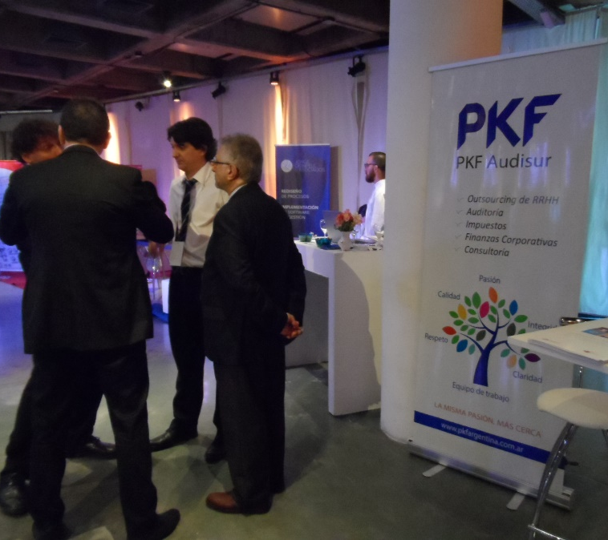
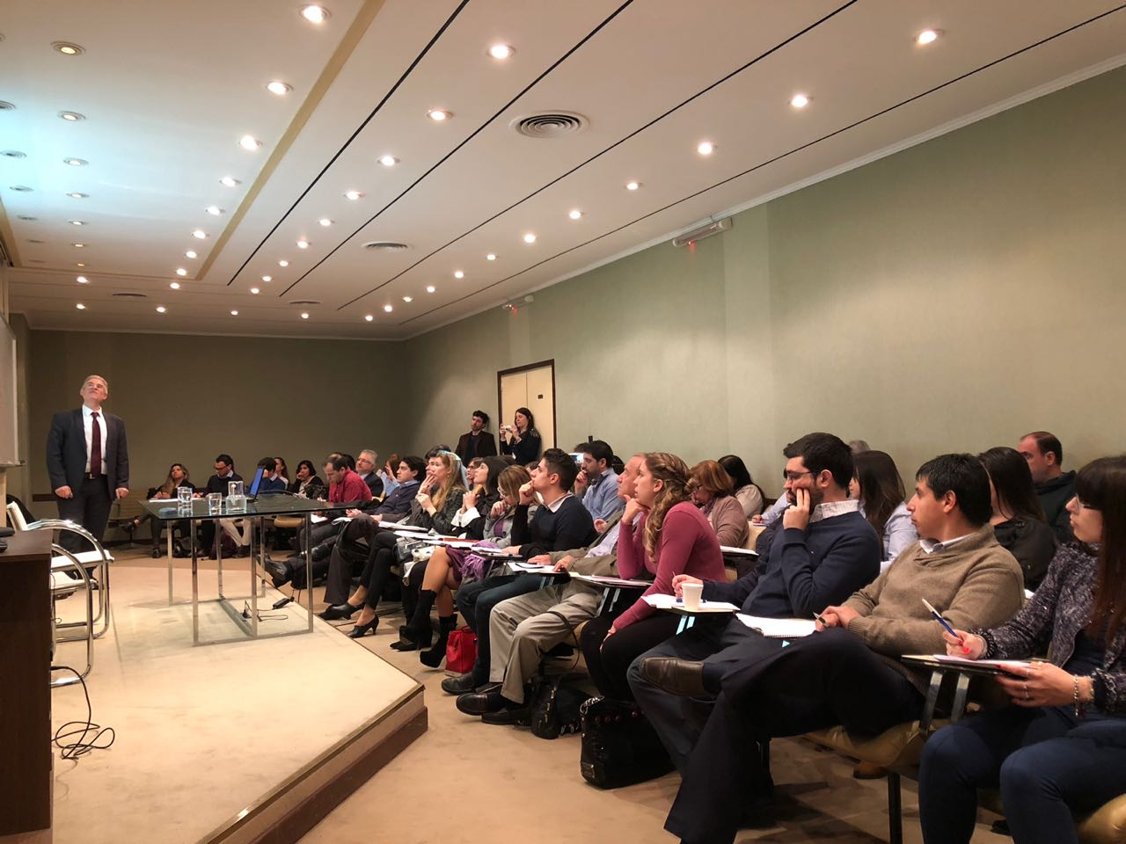
PKF AUDISUR
More than 30 years in the market
We have branch offices in Buenos Aires, Córdoba, Rosario and Mendoza. We are a group of more than 120 professionals in the whole country.
35% of clientes are international companies doing business in Argentina.
Clients from very different sectors, such as: agricultural, real estate, consumer and retailer markets, financial services, industrial, logistics, and technology.
The Business Solutions practice is composed by 10 highly trained professionals, specialized in accounting, tax and payroll management

Slide 14
PKF AUDISUR
More quickly
Because our professional are highly trainer
More easy
Because with our software automate your task
More simple
Because we simplify the management of your organization in all areas
More efficient
Because we are and integrity outsourcing solution

Slide 15
PKF AUDISUR
Contact: Gustavo Hospital
ghospital@pkfargentina.com.ar
Buenos Aires
Sarmiento 663 Floor 3º (C1041 AAM) Buenos Aires Phone: +54 -(11) 5235-6393 Fax: +54 -(11) 5235-6300
www.pkfargentina.com.ar

Slide 16
Brazil

Slide 17
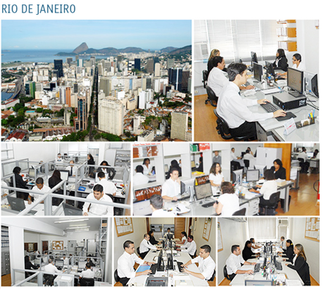
PKF BRAZIL PARTICIPAÇÕES SRL
39 year old in the Market
90 staff total in three different locations in Brazil, serving companies Nationwide.
76% of revenue from international companies doing business in Brazil;
Several Forbes 1000 clientes;

Slide 18
PKF BRAZIL PARTICIPAÇÕES SRL
Running payroll of, currently, 4000 people
HR services in addition to payroll – recruiting, profile reports, functions and wages plan, genral set up consulting
71% of the clients are foreign companies
Focus on delivering international results while keeping local compliance

Slide 19
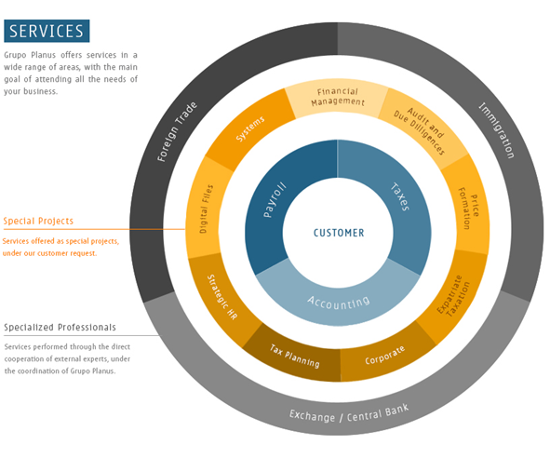
PKF BRAZIL PARTICIPAÇÕES SRL
One stop shop for all accounting needs in Brazil
Payroll services provided as standalone service or part of a larger BPO package

Slide 20
PKF BRAZIL PARTICIPAÇÕES SRL
Contact: Felipe Pestana
felipe.pestana@pkfbrazil.com.br
Rio de Janeiro Avenida Rio Branco, 43 15º/18º/20º andares Centro - Rio de Janeiro, RJ Phone: (55) 21 2211 0011
Macaé Av. Nossa Senhora da Glória, 2.987 - sala 101. Cavaleiros - Macaé, RJ Phone: (55) 22 2765 5373
www.pkfbrazil.com.br
São Paulo Alameda Santos 2.326 sala 76
Jardins – São Paulo – SP
Phone: (55) 11 967 649 722

Slide 21
Chile

Slide 22
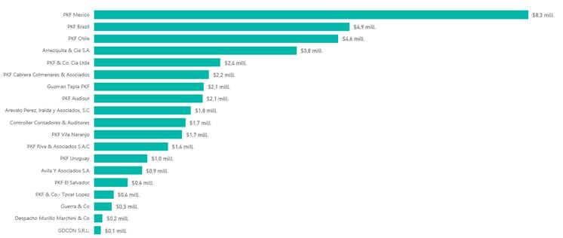
PKF CHILE AUDITORES CONSULTORES LTDA.
One of the leading members firms of PKF International in Latin America, ranked #3 in PKFI LATAM Revenue Ranking.
Over 30 years in the market.
Office located in Santiago.
Staff: 100 professionals from different specialties.
Our clients come from different sectors: Farming, Metallurgy, Packaging, Textile, Commerce, Financial institutions, Public entities, Computing, Imports Chemical, Forestry, Insurance, Food, Investment funds and administrators, Entertainment, Hotels and tourism, Health care, Manufacturing, Concessionaires, Construction, Investment and real estate companies, Services, Non-profit organizations, Fishing, Mining, Shipping and transportation, Telecommunications and Education.
We are a client-oriented firm which is constantly concerned about the requirements of those who have chosen our services.

Slide 23
PKF CHILE AUDITORES CONSULTORES LTDA.
We use the latest technology to communicate with clients.
We apply a permanent technological up-grade policy, which allows us to be in the vanguard of the new available tools.
Our network and equipment allow us to be always available to support our clients.
Our Core Purpose: Be a prestigious Firm, well positioned in the market and leader in providing the highest quality profesional services such as audit, accounting, consulting and taxation.
Our Vision: Be a quality reference.
Our services: Audit, Accounting, Tax & Legal, Payroll Outsourcing, Corporate Finance and Risk Advisory.

Slide 24
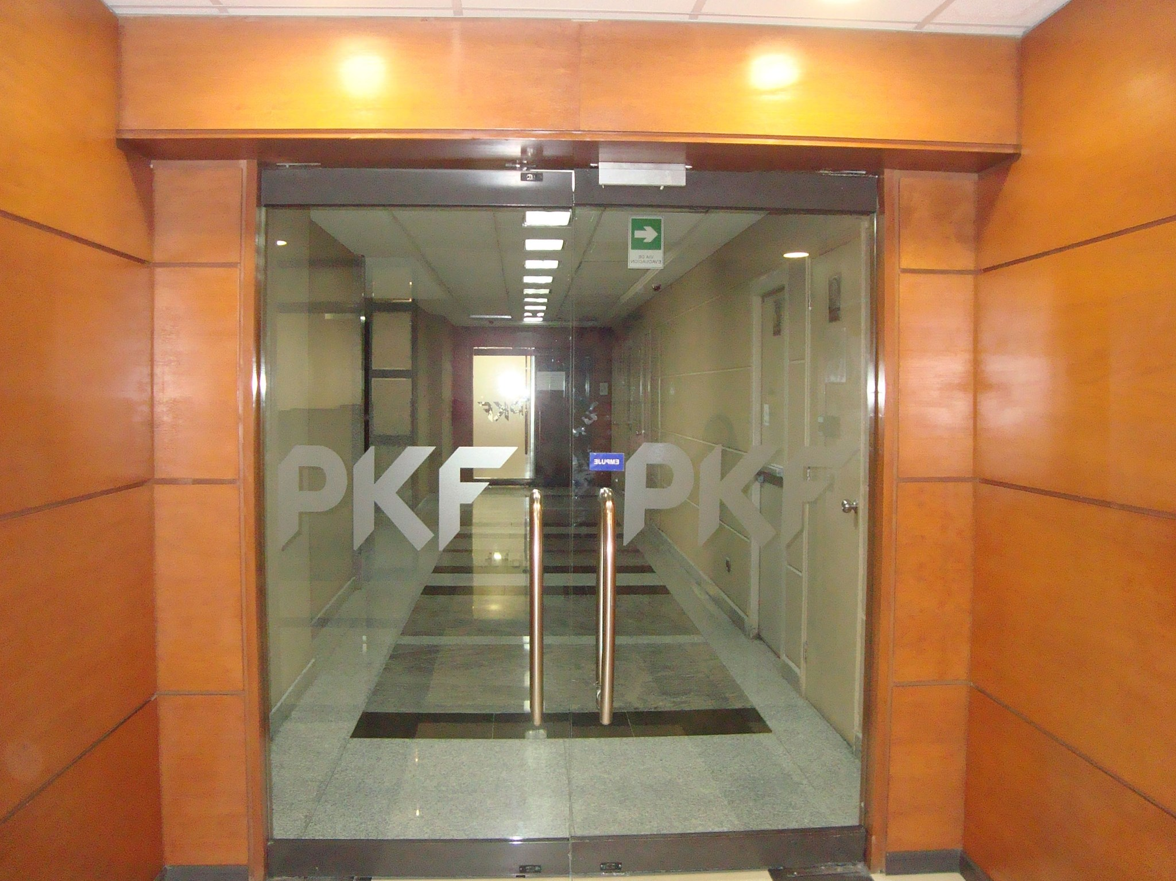
PKF CHILE AUDITORES CONSULTORES LTDA.
Contact: Luis Vicuña C.
lvicuna@pkfchile.com.cl
Santiago
Avenida Providencia 1760, office 603, floor 6
Providencia - Santiago de Chile
Phone: (562) 2650 4300
www.pkchile.cl

Slide 25
Colombia

Slide 26
PKF - AMEZQUITA & CIA SA
Colombian firm leader in Profesional services
Experience over 49 years
Offices in Bogotá and Medellin
With more than 160 professionals from different specialties
National and multinational clients of different sectors

Slide 27
PKF - AMEZQUITA & CIA SA
Our services
Bookkeeping
Payroll Outsourcing
Tax compliance
Accounting and payroll Advisory
Accounting and payroll diagnosis
Human resources support
Account Analysis
Our methodology…
… in Outsourcing processes guarantees the productivity of your company and helps mitigate risks

Slide 28
PKF - AMEZQUITA & CIA SA
Contact: Vivian Amézquita
avivian@amezquita.com.co
Diana Gutiérrez
gdiana@amezquita.com.co
Bogotá
Calle 37 No. 24-28
Bogotá Phone: +57 -(1) 2087500
www.amezquita.com.co

Slide 29
Ecuador

Slide 30
PKF & CO. CÍA. LTDA.
More than 40 years in the market
Offices in Guayaquil and Quito
More than 30 local and foreign clients
Our clients come from very different sectors, from real estate developers to chocolate exporters
The Business Solutions practice is composed by 10 highly trained professionals, specialized in accounting, tax and payroll management
We use Dobra System, a flexible accounting system that enables to automatize and integrate operations of any kind of company

Slide 31
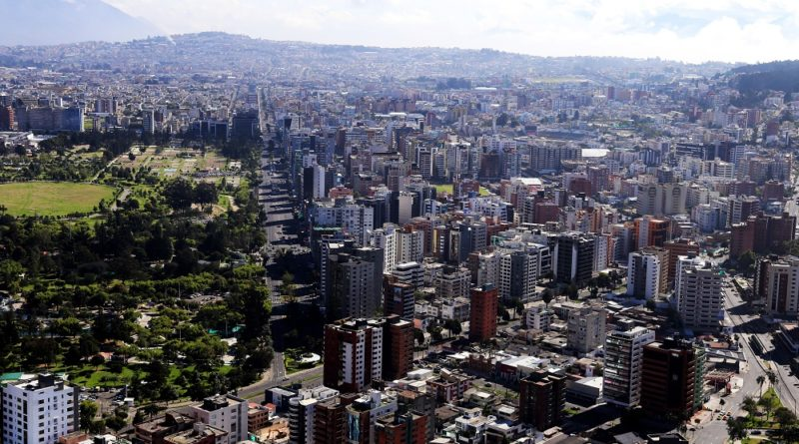
PKF & CO. CÍA. LTDA.
Service always conducted by a Partner
Focus on providing top quality service at a reasonable cost
We appreciate your time
Access to an international network of firms

Slide 32
PKF & CO. CÍA. LTDA.
Contact: Manuel García
mgarcia@pkfecuador.com
Guayaquil Av. 9 de Octubre 1911 y Los Ríos Edificio Finansur Piso 12 Oficina 2
Guayaquil P.O. Box 09-04-763 Phone: (593) 4 2367833
Quito Av. República de El Salvador 836 y Portugal Edificio Prisma Norte Piso 4 Oficina 404
Quito Phone: (593) 2 2263959
www.pkfecuador.com

Slide 33
México

Slide 34
PKF MÉXICO
You can rest assured that PKF Mexico has professionals with international experience in their market place and at a global level through the support of network members

Slide 35
PKF MÉXICO
Offices in the main cities of 7 states
Mexico City
Cancun
Cuernavaca
Guadalajara
Merida
Monterrey
Queretaro

Slide 36
PKF MÉXICO
Our Vision
Services designed according to specific needs
We strive so that our professional services meet the specific objectives of our clients
Our Mission
“Provide quality services focusing on the specific needs of each client through creative solutions based on practical experience and vast knowledge.”

Slide 37
Our services
Audit
Tax
Consultancy
Business Solutions
Risk Consultancy
Government
Legal
Outsourcing
Transfer Pricing
Strategy Planning
Corporate Governance
Financial Services
Internal Audit
Public Sector

Slide 38
PKF MÉXICO
Contact: Mónica L. Williams Díaz
mwilliams@pkfmex.com
C.P.C. Antonio G. Garmilla Belmar
agarmilla@pkfmex.com
Ciudad de México
Adolfo Prieto No. 1213
Col. Del Valle
Ciudad de México
Phone: +52 55 5097 3235 Fax: +52 55 5682 4321
www.pkfmexico.com

Slide 39
Paraguay

Slide 40
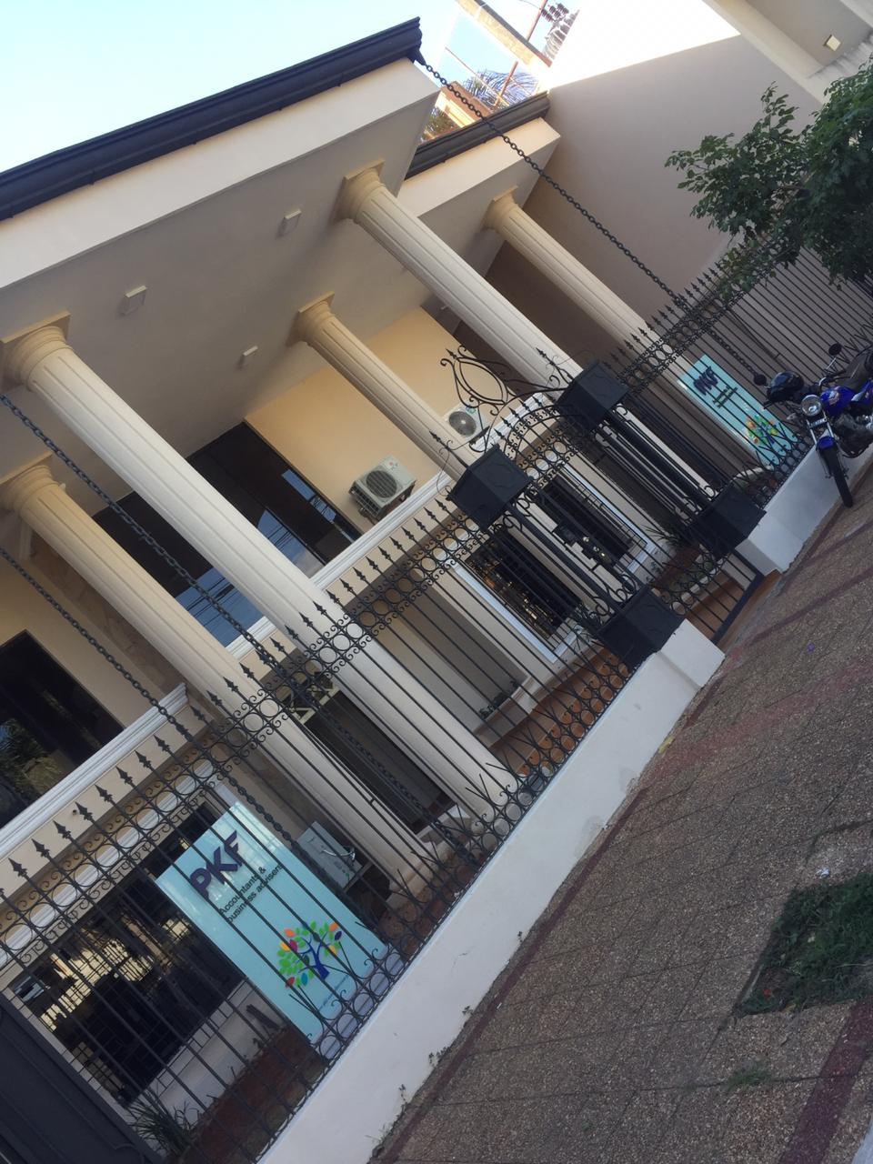
PKF CONTROLLER
23 year old in the local market, 15 with PKF.
101 total staff in two diferents locations in Paraguay, Asunción and Ciudad del Este, serving companies Nationwide.

Slide 41
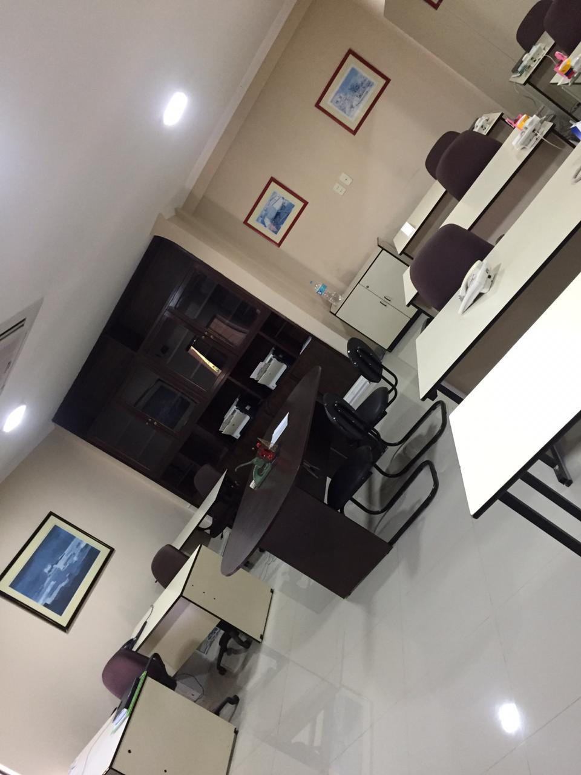
PKF CONTROLLER
The main objetive is obtain better results for you Company. The PKF staff is un charge of the Business Solution and it has very good references worldwide in the advisory services that it ofters to clients, resulting in better business practices.

Slide 42
PKF CONTROLLER
Our staff has a variety of types of Consultancy for the market.
Human Resources Services
Organization and Business Proceses
Information Technology
Agreed Procedures
Tax compliance
Accounting Outsourcing
Payroll Outsourcing
Accounting and Payroll Advisory
Inventories.

Slide 43
PKF CONTROLLER
Contact: Hector Cáceres
hcaceres@pkf-controller.com.py
Asunción Cecilio Da Silva e/ Papa Juan XXIII y Narciso R. Colmán
Asunción
Phone: (595) 21 603044
Ciudad del Este Av. Mcal. López y Calle 5
Barrio San José Edificio Corporativo Beck, Oficina 101 y 102
Ciudad del Este Phone: (595) 61 511610
www.pkf-controller.com.py

Slide 44
Perú

Slide 45
PKF VILA NARANJO
We are a Peruvian Audit and Business Consulting Firm incorporated in 1975 and since 1983, Member Firm of PKF International.
PKF VNA, given the high quality and ethical values exercised in rendering its services, is considered by the business and financial market as one of the first Audit and Consulting Firms; being recognized in Peru as an “A” Category Firm. Since several years ago, it has been technically positioned within the top 8 in Peru.

Slide 46
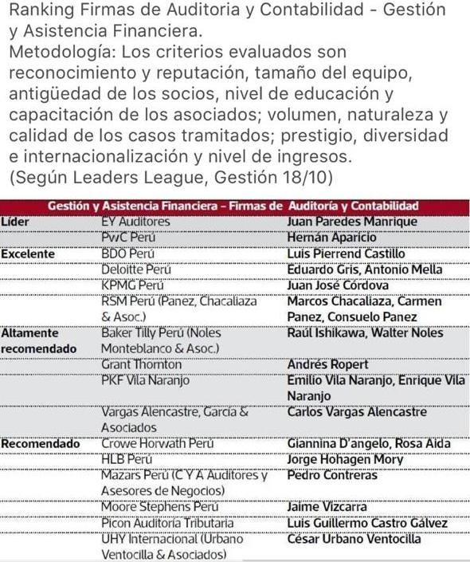
PKF VILA NARANJO
PKF Vila Naranjo with more than 40 years of experience in the market has a commitment to deliver a high level quality service together with the auditors and consultants added value who know their culture and business environment.
We are constantly investing resources every year to improve the technical capacities of our partners and collaborators through seminars and training programs both locally and internationally.

Slide 47
PKF VILA NARANJO
Our staff has a variety of types of Consultancy for the market.
Risk Assesment
Tax and Legal Services
Fixed Asset and Stock Inventories
Corporate Finance
Operational Consultancy
Information Technology
Agreed Procedures
Transfer Pricing
IFRS Adoption

Slide 48
PKF VILA NARANJO
Contact: Esteban Hilgert
ehilgert@pkfperu.com
Lima
Av Paseo de la República 3557 – 2 Piso San Isidro - Lima
Phone: + 511 441 5553
Phone : + 511 442 6116
Phone : + 511 421 6250
www.pkfperu.com

Slide 49
Uruguay

Slide 50
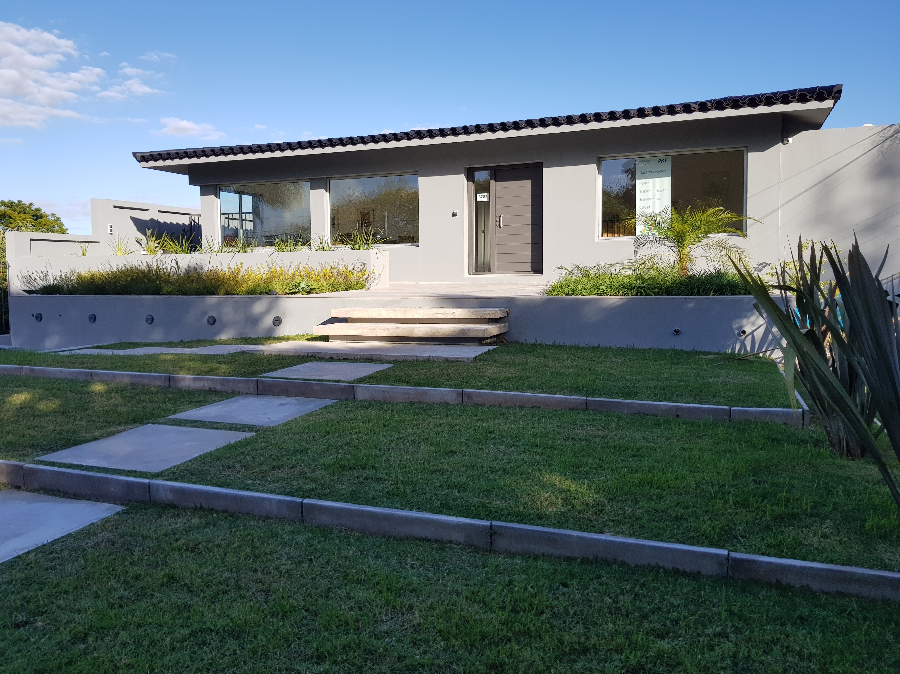
PKF URUGUAY
60 year old in the market,
23 with PKF
Office in Montevideo
More than 30 staff, serving companies Nationwide
15% of clientes are international companies doing business in Uruguay

Slide 51
PKF URUGUAY
Clients from very different sectors, such as: agricultural, real estate, consumer and retailer markets, financial services, industrial, logistics, technology and media.
The Business Solutions practice is composed by 18 highly trained professionals, specialized in corporate and business advice, accounting, tax and payroll management.

Slide 52
PKF URUGUAY
One stop shop for all accounting, tax and human resourses needs in Uruguay.
Mission: to provide a quality service focused on the specific needs of each client.
Commitment: experience and personalized attention.
Philosophy: deliver added value to our customers.

Slide 53
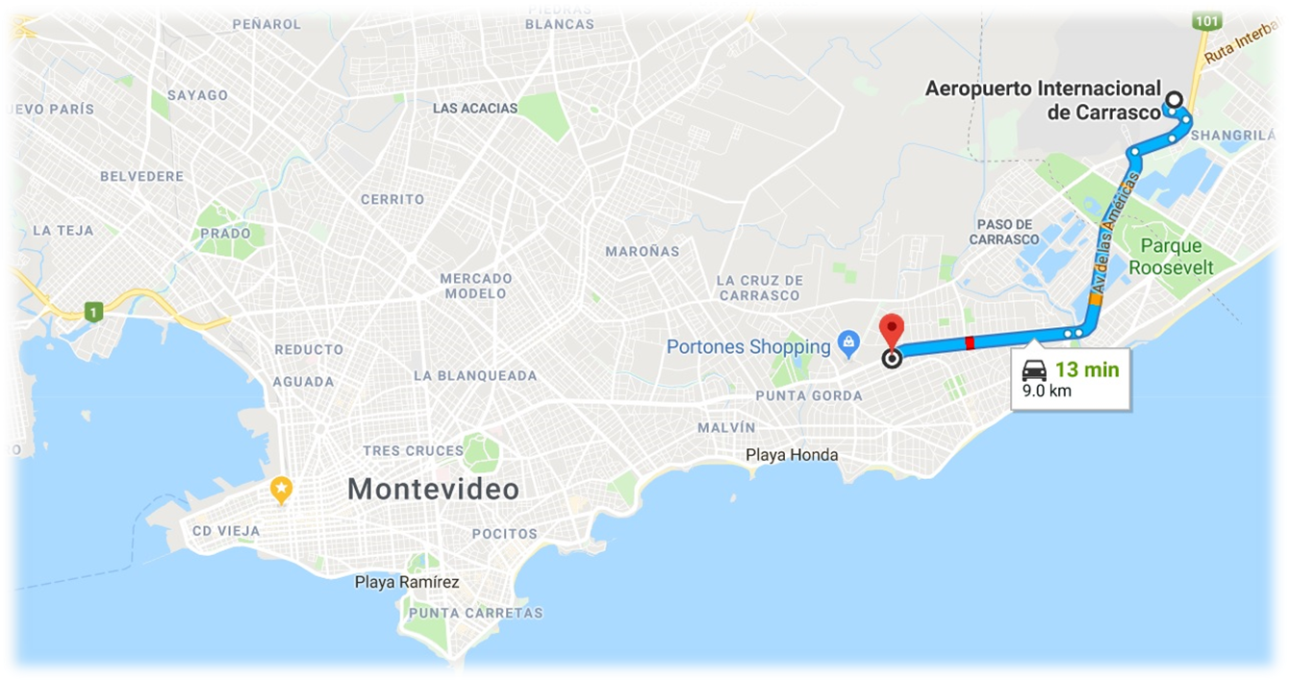
PKF URUGUAY
Contact: Fernando Saltó
fsalto@pkfuruguay.com.uy
Montevideo
Avenida Italia 6282
Montevideo
CP 11.500
Phone: (598) 2600 2255
Phone: (598) 26050133
Phone: (598) 26051420
www.pkfuruguay.com.uy

Slide 54
Venezuela

Slide 55
PKF CARPENTIERI COLMENARES & ASOCIADOS
More than 40 years in the market
Offices in Caracas
More than 30 local and foreign clients
PKF Venezuela can provide your business with a range of accounting and business advisory services within a number of sectors including Mining and Energy, Manufacturing, Not-for-Profit, Construction and Real Estate, Hotels Consulting, Government and Public Sector, Professional Services and Technology, Media and Communications (TMC).
The Business Solutions practice is composed by 15 highly trained professionals, specialized in accounting, tax and payroll management
We use Profit Plus, a flexible accounting system that enables to automatize and integrate operations of any kind of company

Slide 56
PKF CARPENTIERI COLMENARES & ASOCIADOS
Our services
Bookkeeping
Payroll Outsourcing
Tax compliance
Accounting and payroll Advisory
Accounting and payroll diagnosis
Human resources support
Account Analysis
… in Outsourcing processes guarantees the productivity of your company and helps mitigate risks
Our methodology…

Slide 57
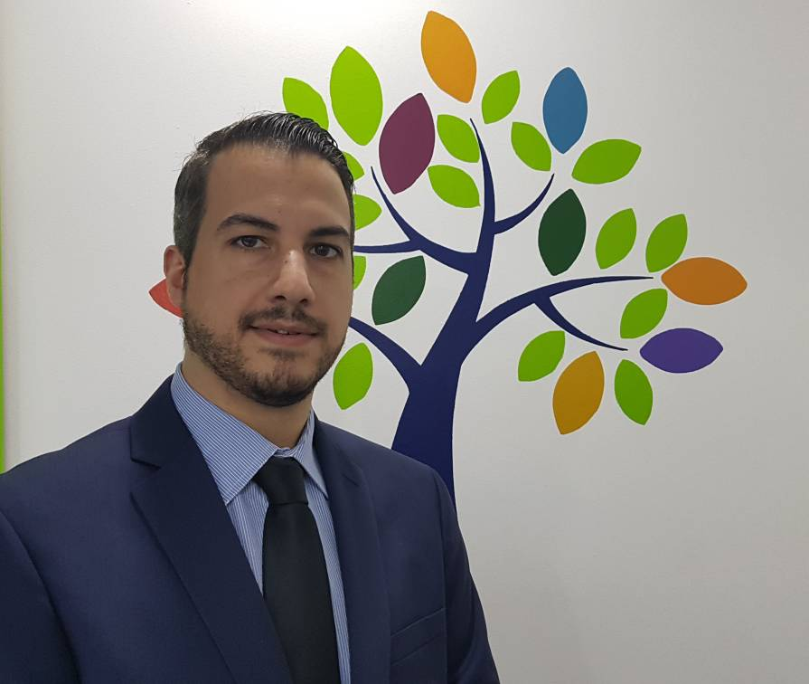
PKF CARPENTIERI COLMENARES & ASOCIADOS
Contact: Tomas Carpentieri F.
tcarpentieri@pkfve.com
Caracas Av. Tamanaco, Torre Centro Seguros
Sudamerica, Piso 2, Ofc. 2H, El Rosal, Caracas 1060 Phone: (58) 212 952 4050
www.pkfve.com

